Slide 1

NetHive: Advanced Internet Management Systems for Events via a Centralized Web Portal
11 October 2025
Presented By: Md. Mahabubur Rahman
PMIT 27th Batch pre
Supervisor: Professor Shamim Al Mamun, PhD
Student ID:223228

Slide 2
01
The Problem: Statement of some real Problems.
05
Performance & Security
02
The Solution: Introducing NetHive
Introduction
06
Conclusion & Future Work
03
System Architecture & Design
07
Q&A + Thank You
04
Technical Implementation

Slide 3
01
Complexity: Managing network devices often requires specialized knowledge of network administration.
Inefficiency: Manual configuration is time-consuming, prone to errors, and difficult to scale.
02
The Problem: Challenges in providing a stable network for corporate events or conferences.
03
Lack of Centralization: Administering multiple routers across different locations is disjointed.
Poor User Experience: Traditional tools are not user-friendly, especially for dynamic environments like events or small ISPs.
04
Insufficient Security: Due to sharing username and password, it works on an open wifi, which creates a cyber risk factor
05
Post Logging and Reporting: For future analysis post event data mostly unavailable.
06

Slide 4
01
RADIUS for Centralized AAA
Existing Network Managments
02
pfSense
03
CoovaChilli

Slide 5

The Solution: Introducing NetHive

Slide 6



System Architecture
NetHive follows a three-tier architectural pattern
Tier 1
Tier 2
Tier 3
Presentation Layer (Client)
Application Logic Layer (Server)
Service/Data Layer (Router)

Slide 7
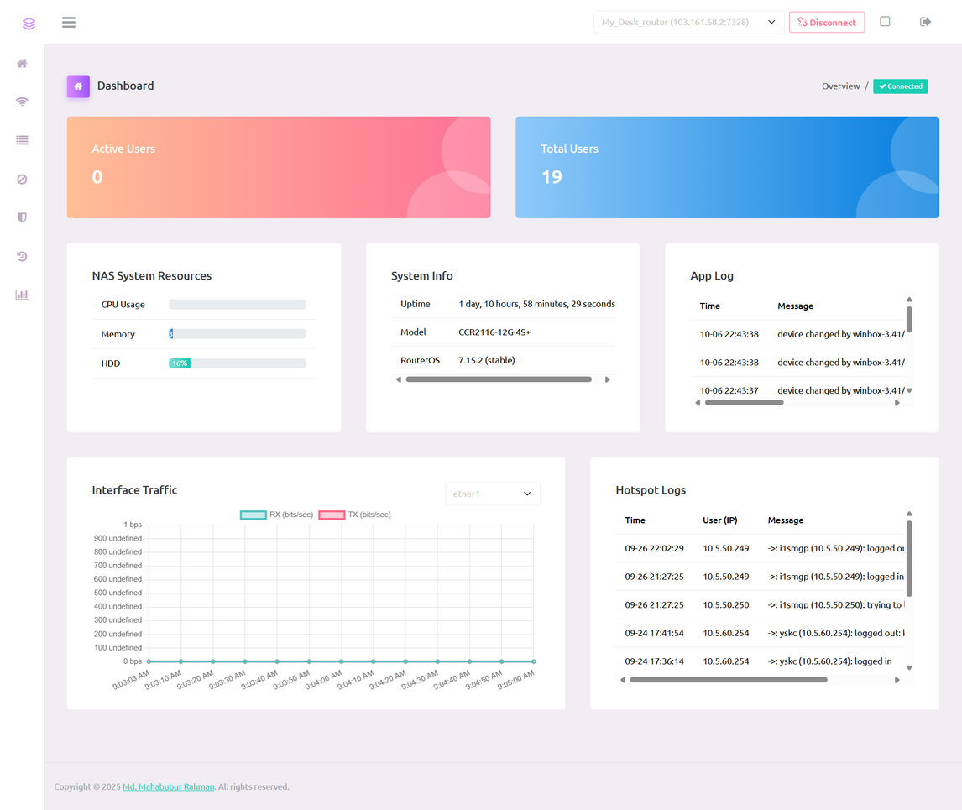
Core Feature 1: The Dashboard
* Real-time Monitoring: Live CPU, Memory, and Disk usage of the connected router.
* System Information: RouterOS version, uptime, and model.
* Live Traffic Graphs: Visual representation of data flowing through network interfaces.
* User Statistics: See active hotspot users and total user counts instantly.

Slide 8
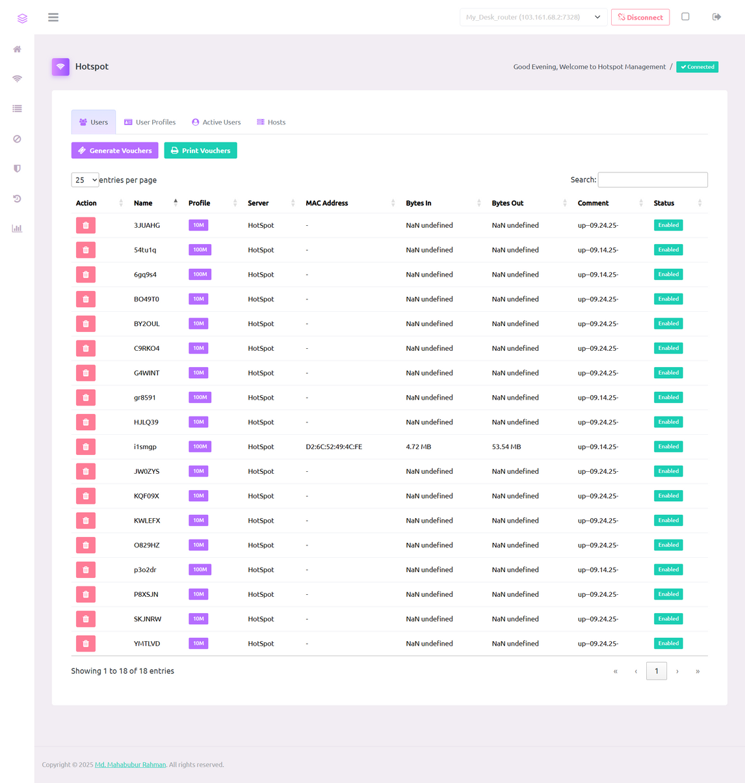
Core Feature 2: Hotspot Management
* One-Click User Generation: Instantly create hotspot users with specific profiles (time/data limits).
* Bulk Voucher System: Generate hundreds of unique vouchers for events or sale.
* Printable Vouchers: Includes a simple interface to print generated vouchers with QR codes.
* Active Session Monitoring: See who is connected to your hotspot in real-time.

Slide 9
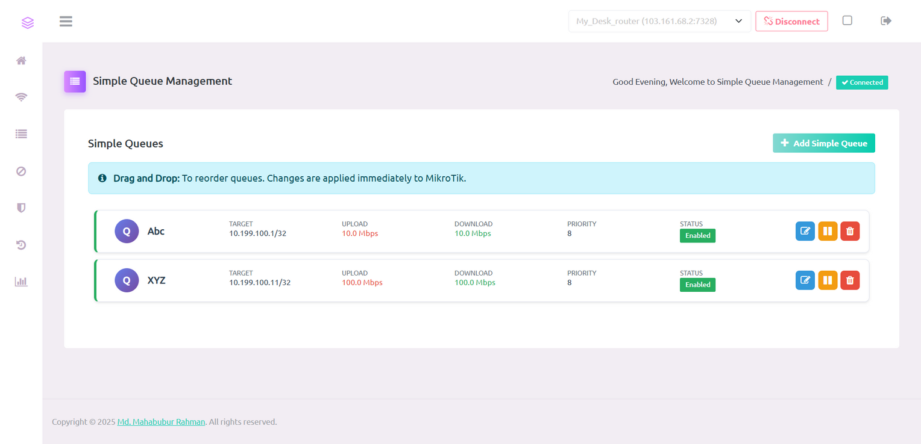
Core Feature 3: Queue Management
* Visual Prioritization: Simply drag and drop users to change their bandwidth priority.
* Simple Queues: Easily create and manage bandwidth limits (e.g., 1Mbps, 10Mbps, 50Mbps) for different users or IP addresses.
* Real-time Updates: Changes are applied to the router instantly.
* Target Discovery: Automatically detects active clients to simplify queue creation.

Slide 10
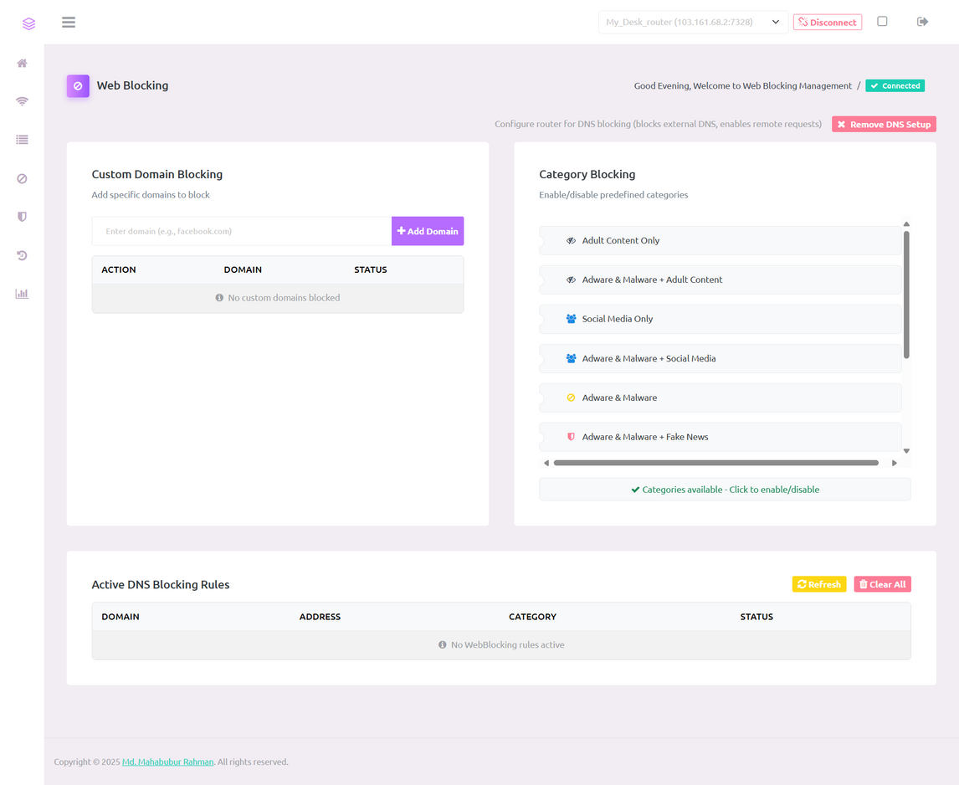
Core Feature 4: Web Blocking
* One-Click Filtering: Block entire categories like Social Media, Ads, Malware, or Adult Content.
* Custom Rules: Add your own specific domains to a blocklist.
* DNS-Based: Works by configuring the router''s DNS server to refuse to look up blocked sites.
* Based on Industry Lists: Utilizes well-maintained host lists (like Steven Black''s list) for comprehensive blocking.

Slide 11
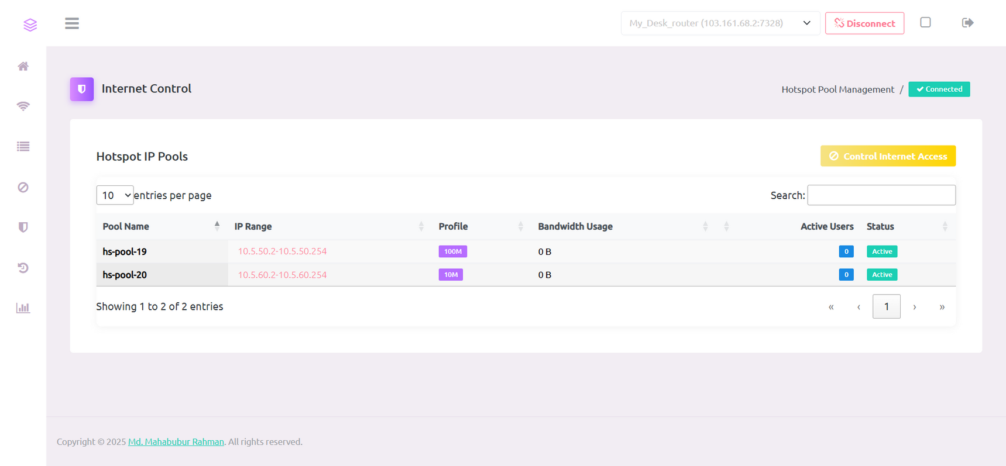
Core Feature 5: Internet Control
* Pool Blocking: Block internet access for an entire IP range (e.g., all computers in a lab).
* Selective Bypass: While a pool is blocked, you can grant internet access to specific users or devices within that pool.
* Firewall Automation: The system intelligently creates and manages the necessary firewall rules on the router for you.

Slide 12
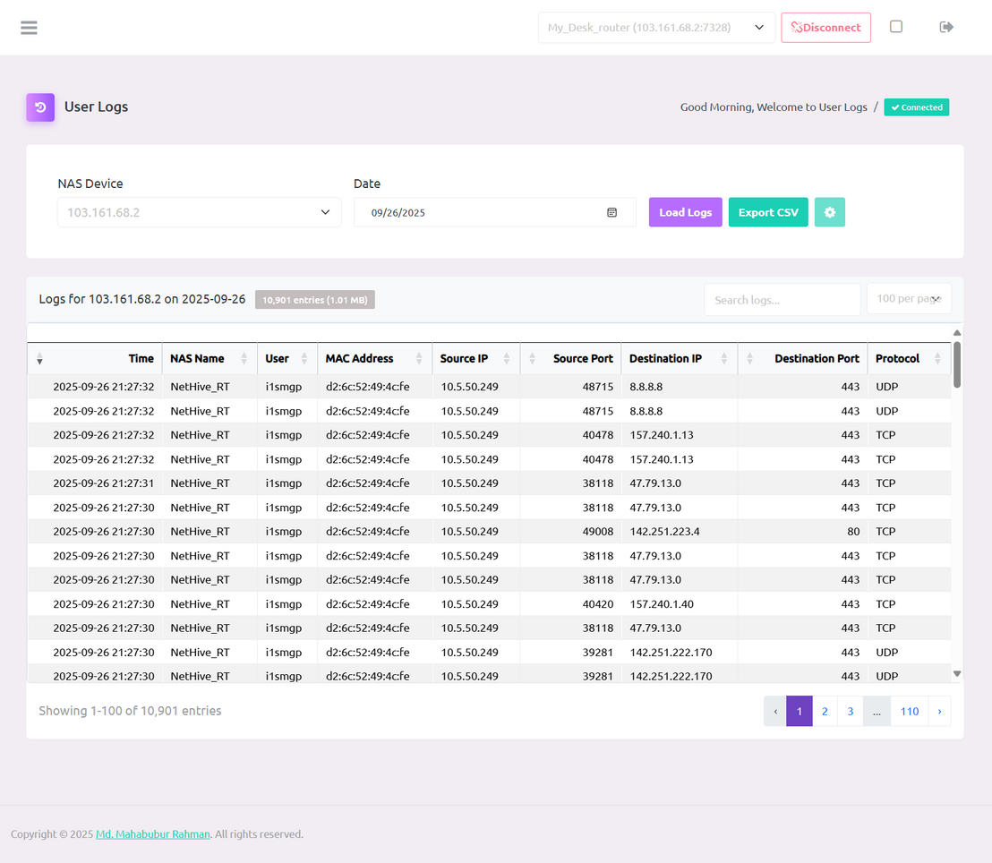
Core Feature 6: High-Performance User Logs
* The Challenge: A 5GB log file can crash a server if read into memory all at once.
* The Solution: File Streaming:** NetHive reads the log file line-by-line, using minimal memory.
* Result: A performance increase. What took 60 seconds now takes less than 100ms.
* Features: Includes fast pagination, debounced real-time search, and CSV export.

Slide 13
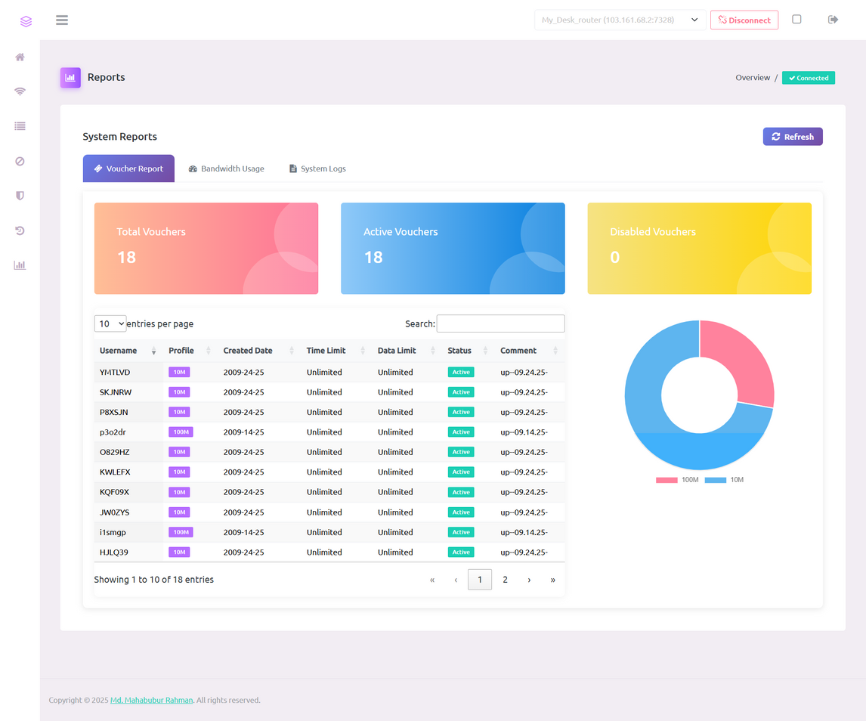
Core Feature 7: Reports & Analytics
* Voucher Analytics: Track voucher sales, usage, and popularity of different plans.
* Bandwidth Reports: Identify peak usage times and top data consumers.
* Data Visualization: Uses Chart.js to create clear, easy-to-understand graphs and charts.

Slide 14
Performance Optimizations
* File Streaming: The key to our 99.8% performance gain in log viewing.
* Conditional Asset Loading: Only loads the necessary CSS and JS for the current page, reducing load times.
* Asynchronous Operations (AJAX): The UI remains responsive while data is fetched in the background.
* Debounced Search: Reduces server load by minimizing search requests as the user types.

Slide 15
01
Complete API Protection: All API endpoints require authentication and role-based authorization. Direct access is blocked.
Role-Based Access Control (RBAC): Three distinct roles (Admin, Operator, Viewer) with different permissions.
02
Enterprise-Grade Security
03
Password Hashing: User passwords are encrypted using modern `bcrypt` hashing.
Directory Protection: `.htaccess` rules prevent web access to sensitive folders like `/data` and `/api`.
04

Slide 16
01
Unified Management: Successfully created a single, intuitive interface to manage complex router features.
Project Achievements
02
Enhanced Security: Implemented a robust, multi-layered security model to protect the system and the network.
03
Resilience: The core network (hotspot, queues) continues to function even if the NetHive server goes offline.
04
High Performance: Solved the large-file problem with an efficient log viewer, demonstrating a high performance boost.

Slide 17

Future Work & Expansion
Immediate Enhancements:
* Real-time notifications (WebSockets)
* Dark Mode
* Multi-language support
Advanced Features:
* Automated configuration backups
Enterprise Integration:
* Billing and payment gateway integration
* Migrate from JSON to a SQL database for massive scale.

Slide 18



01
It empowers users with powerful tools without requiring expert knowledge.
It provides a scalable and cost-effective solution for small ISPs, event managers, and offices.
Conclusion
02
03
Its robust architecture ensures high performance and enterprise-grade security.

Slide 19
Thank You
11 October 2025
Md. Mahabubur Rahman
Student ID: 223228
Supervisor: Professor Shamim Al Mamun, PhD

